Slide 1
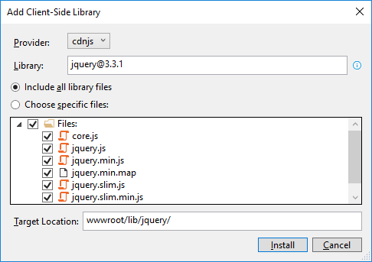
How to add the Bootstrap and jQuery libraries
Start Visual Studio and open a project. In the Solution Explorer, expand the wwwroot/lib folder and delete any old Bootstrap or jQuery libraries.
In the Solution Explorer, right-click on the project name and select the Add→Client-Side Library item.
In the dialog box that appears, “jquery@”, “popper.js”, “jquery-validate”, and “twitter-bootstrap”(but change the target location to “www/lib/bootstrap” for this one).

Slide 2
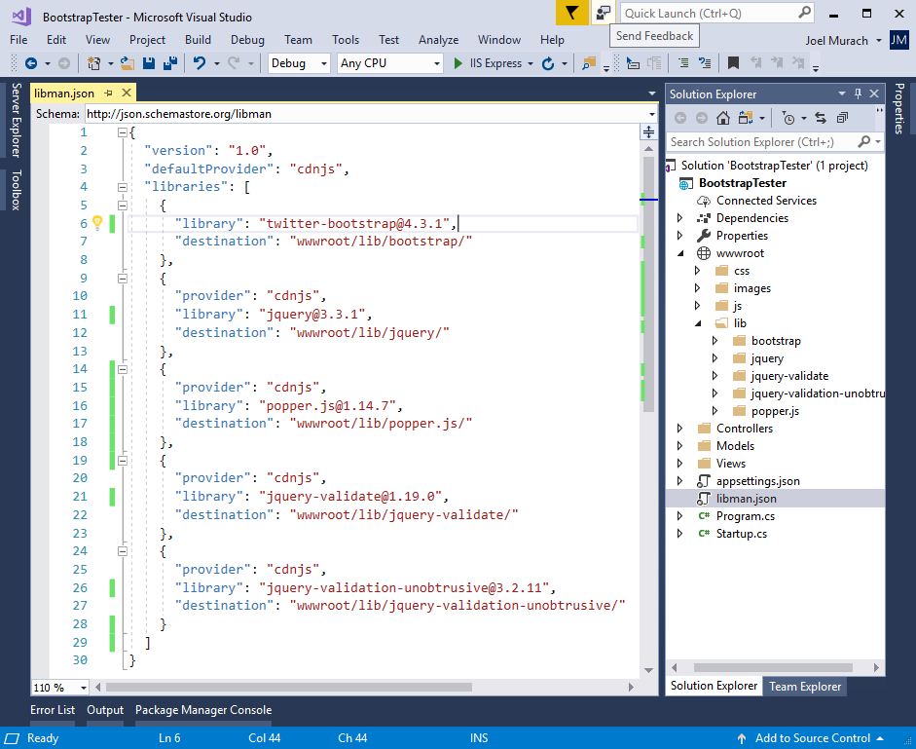
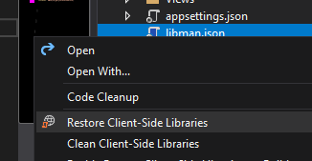
The libman.json file for the client-side libraries
Clean to delete
Restore to restore
(-> restores based on the dependencies written on the code)

Slide 3
A Razor layout that enables client-side libraries
<!DOCTYPE html>
<html>
<head>
<meta name="viewport" content="width=device-width" />
<title>@ViewData["Title"]</title>
<link rel="stylesheet"
href="~/lib/bootstrap/css/bootstrap.min.css" />
<link rel="stylesheet" href="~/css/custom.css" />
<script src="~/lib/jquery/jquery.min.js"></script>
<script src="~/lib/popper.js/popper.min.js"></script>
<script src="~/lib/bootstrap/js/bootstrap.min.js"></script>
<script src="~/lib/jquery-validate/
jquery.validate.min.js"></script>
<script src="~/lib/jquery-validation-unobtrusive/
jquery.validate.unobtrusive.min.js"></script>
</head>
<body>
@RenderBody()
</body>
</html>

Slide 4
An extra directory that may be included by the MVC template
<link rel="stylesheet"
href="~/lib/bootstrap/dist/css/bootstrap.min.css" />

Slide 5
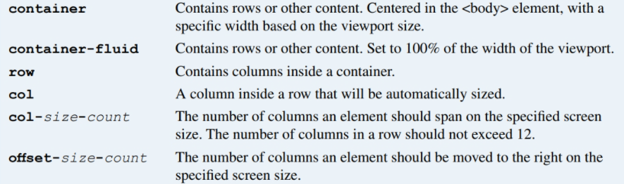
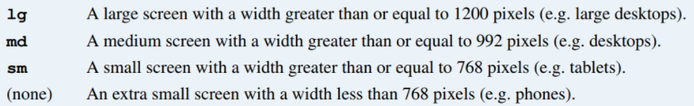
Valid Bootstrap class values
Valid size values

Slide 6
The HTML for a grid
<main class="container">
<div class="row">
<div class="col-12">Column 1</div>
<div class="col-12">Column 2</div>
</div>
<div class="row">
<div class="col-md-4">Column 1</div>
<div class="col-md-8">Column 2</div>
</div>
<div class="row">
<div class="col-md-4 col-sm-6">Column 1</div>
<div class="col-md-8 col-sm-6">Column 2</div>
</div>
</main>
An element that is moved one column to the right on medium screens
<div class="col-md-4 offset-md-1">
This element is offset by one column
</div>

Slide 7
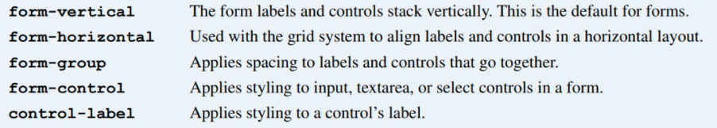
Bootstrap CSS classes for forms

Slide 8
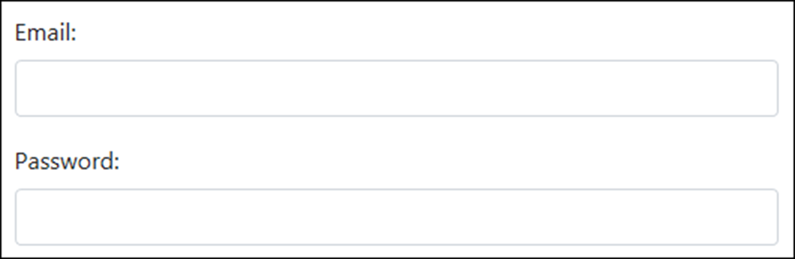
The HTML for the form in vertical layout
<form asp-action="Login" method="post">
<div class="form-group">
<label for="email">Email:</label>
<input type="email" id="email" class="form-control" />
</div>
<div class="form-group">
<label for="pwd">Password:</label>
<input id="pwd" type="password" class="form-control" />
</div>
</form>

Slide 9
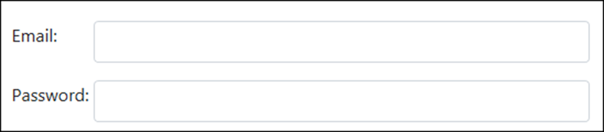
The HTML for the form in horizontal layout
<form asp-action="Login" method="post">
<div class="form-group row">
<label for="email" class="col-sm-2">Email:</label>
<div class="col-sm-10">
<input type="email" id="email" class="form-control" />
</div>
</div>
<div class="form-group row">
<label for="pwd" class="col-sm-2">Password:</label>
<div class="col-sm-10">
<input type="password" id="pwd" class="form-control" />
</div>
</div>
</form>

Slide 10
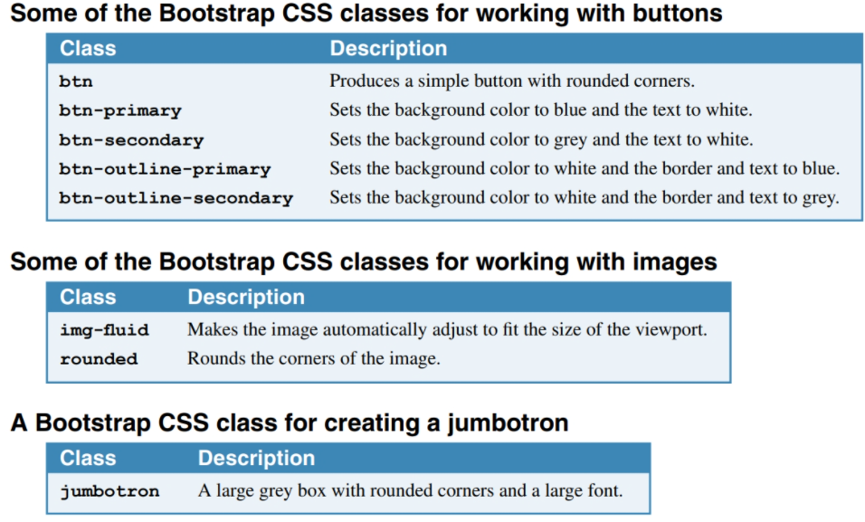

Slide 11
The HTML for the jumbotron, image, and buttons
<div class="container">
<header class="jumbotron">
<img id="logo" alt="Murach logo"
src="~/images/MurachLogo.jpg"
class="img-fluid rounded" />
</header>
<main>
<form asp-action="Index" method="post">
<span class="mr-2">I accept the terms for this site:
</span>
<button type="submit" class="btn btn-primary">
Yes
</button>
<button id="btnNo" class="btn btn-outline-secondary">
No
</button>
</form>
</main>
</div>

Slide 12
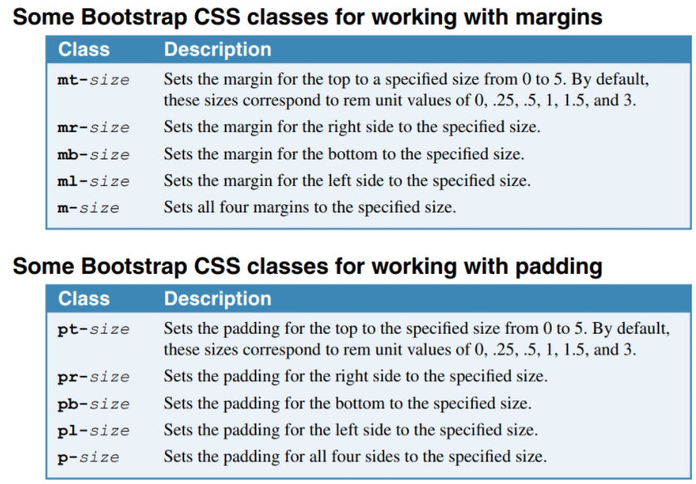

Slide 13
The code for the Index view (part 1)
@model FutureValueModel
@{
ViewBag.Title = "Future Value Calculator";
}
<div class="container">
<header class="jumbotron">
<img id="logo" alt="Murach logo"
src="~/images/MurachLogo.jpg"
class="img-responsive rounded" />
<h1 class="mt-3">@ViewBag.Title</h1>
</header>
<main>
<form asp-action="Index" method="post">
<div class="row form-group">
<label asp-for="MonthlyInvestment"
class="col-sm-3">Monthly Investment: </label>
<div class="col-sm-3">
<input asp-for="MonthlyInvestment"
class="form-control" />
</div>
<span asp-validation-for="MonthlyInvestment"
class="col text-danger"></span>
</div>

Slide 14
The code for the Index view (part 2)
<div class="row form-group">
<label asp-for="YearlyInterestRate"
class="col-sm-3">Yearly Interest Rate:
</label>
<div class="col-sm-3">
<input asp-for="YearlyInterestRate"
class="form-control" />
</div>
<span asp-validation-for="YearlyInterestRate"
class="col text-danger"></span>
</div>
<div class="row form-group">
<label asp-for="Years" class="col-sm-3">
Number of Years: </label>
<div class="col-sm-3">
<input asp-for="Years" class="form-control" />
</div>
<span asp-validation-for="Years"
class="col text-danger"></span>
</div>

Slide 15
The code for the Index view (part 3)
<div class="row form-group">
<label class="col-sm-3">Future Value:</label>
<div class="col-sm-3">
<input value="@ViewBag.FutureValue" readonly
class="form-control" />
</div>
</div>
<div class="row form-group">
<div class="col offset-sm-3">
<button type="submit" class="btn btn-primary">
Calculate</button>
<a asp-action="Index"
class="btn btn-outline-secondary">Clear</a>
</div>
</div>
</form>
</main>
</div>

Slide 16
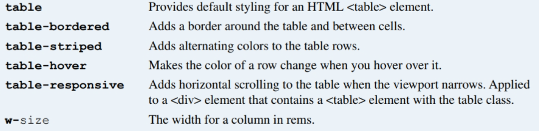
CSS classes for working with HTML tables
<table class="table table-striped table-bordered table-hover">...

Slide 17
The HTML for the table
<table class="table">
<thead>
<tr>
<th>Department</th>
<th>Phone Number</th>
<th>Extension</th></tr>
</thead>
<tbody>
<tr>
<td>General</td>
<td>555-555-5555</td>
<td>1</td></tr>
<tr>
<td>Customer Service</td>
<td>555-555-5556</td>
<td>2</td></tr>
<tr>
<td>Billing and Accounts</td>
<td>555-555-5557</td>
<td>3</td></tr>
</tbody>
</table>

Slide 18
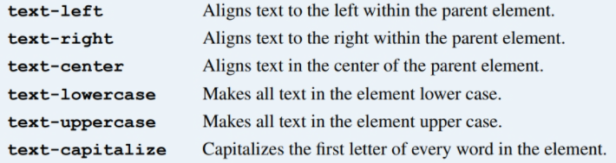
Common CSS classes for text

Slide 19
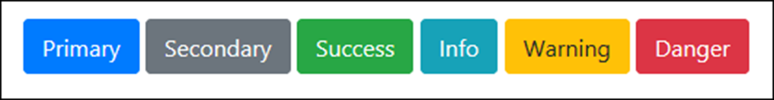
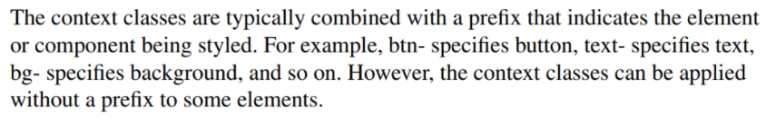
The context classes available to most elements
Class Default color
primary Dark blue
secondary Gray
success Green
info Light blue
warning Orange
danger Red
light White
dark Gray
btn-primary
text-success
bg-warning

Slide 20
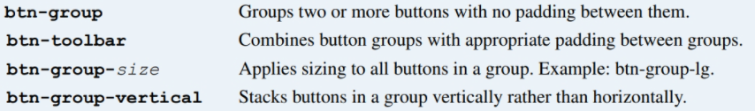
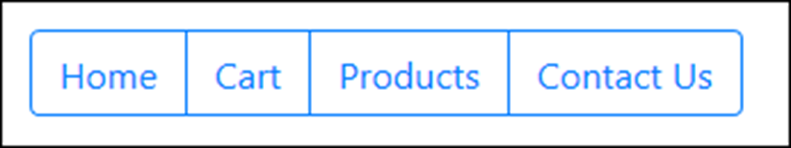
Common CSS classes for creating button groups
The HTML for the button group
<div class="btn-group" role="group"
aria-label="Button group">
<a href="/" class="btn btn-outline-primary">Home</a>
<a href="/cart" class="btn btn-outline-primary">
Cart</a>
<a href="/products" class="btn btn-outline-primary">
Products</a>
<a href="/contact-us" class="btn btn-outline-primary">
Contact Us</a>
</div>

Slide 21

A toolbar with two button groups
The HTML for the button groups
<div class="btn-toolbar" role="toolbar"
aria-label="Toolbar with groups">
<div class="btn-group mr-2" role="group"
aria-label="First group">
<a href="/" class="btn btn-outline-primary">Home</a>
<a href="/Cart" class="btn btn-outline-primary">Cart</a>
</div>
<div class="btn-group" role="group" aria-label="Second group">
<a href="/products" class="btn btn-outline-primary">
Products</a>
<a href="/contact-us" class="btn btn-outline-primary">
Contact Us</a>
</div>
</div>

Slide 22
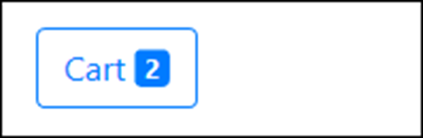
A button with a badge
The HTML for the button
<a href="/cart" class="btn btn-outline-primary">
&nbsp;Cart&nbsp;
<span class="badge badge-primary">2</span>
</a>

Slide 23
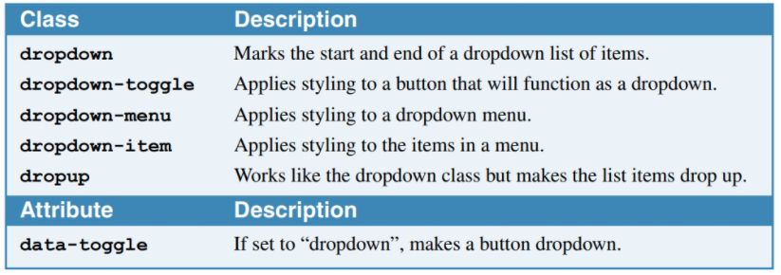
CSS classes for creating button dropdowns

Slide 24
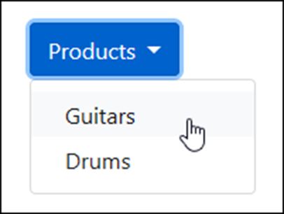
A button dropdown
The HTML for the button dropdown
<div class="dropdown">
<button type="button" class="btn btn-primary dropdown-toggle"
id="productsDropdown" data-toggle="dropdown"
aria-haspopup="true" aria-expanded="false">Products
</button>
<div class="dropdown-menu" aria-labelledby="productsDropdown">
<a class="dropdown-item"
href="/product/list/guitars">Guitars</a>
<a class="dropdown-item"
href="/product/list/drums">Drums</a>
</div>
</div>

Slide 25
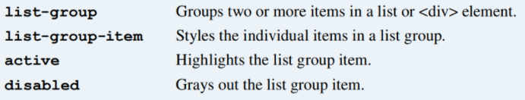
Common CSS classes for creating list groups

Slide 26
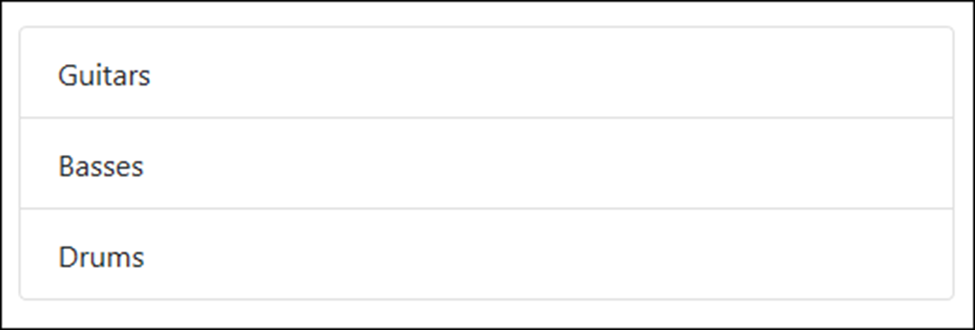
A basic list group
The HTML for the list group
<ul class="list-group">
<li class="list-group-item">Guitars</li>
<li class="list-group-item">Basses</li>
<li class="list-group-item">Drums</li>
</ul>

Slide 27
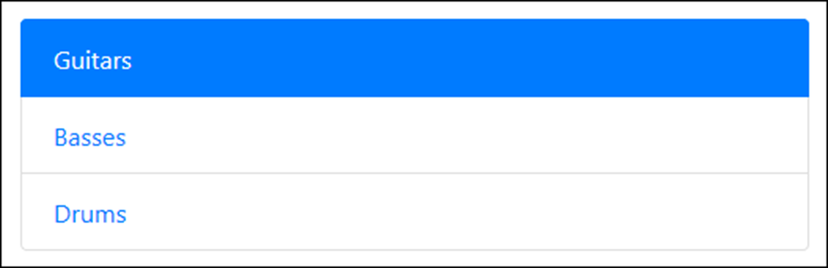
Another basic list group with an active item
The HTML for the list group
<div class="list-group">
<a href="/guitars" class="list-group-item active">
Guitars</a>
<a href="/basses" class="list-group-item">Basses</a>
<a href="/drums" class="list-group-item">Drums</a>
</div>

Slide 28
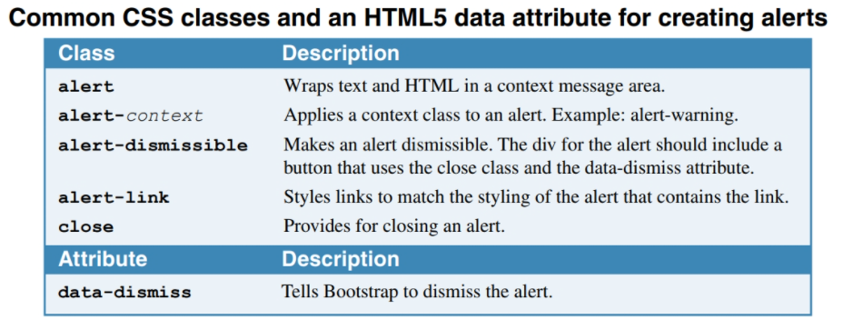

Slide 29
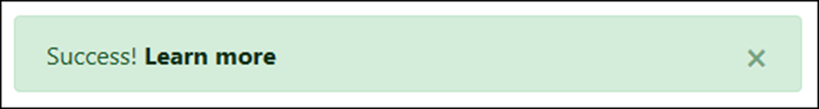
A dismissible alert with a link
The HTML for the alert
<div class="alert alert-success alert-dismissible">
<button class="close" data-dismiss="alert">
&times;
</button>
Success! <a href="#" class="alert-link">
Learn more</a>
</div>

Slide 30
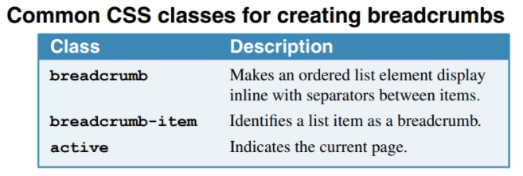

Slide 31
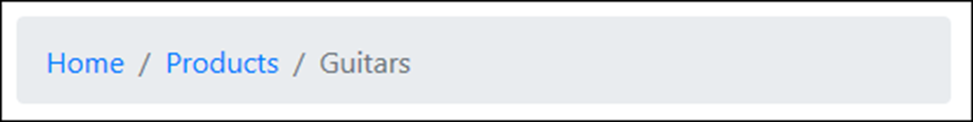
A breadcrumb with three segments
The HTML for the breadcrumb
<nav aria-label="breadcrumb">
<ol class="breadcrumb">
<li class="breadcrumb-item">
<a href="/">Home</a>
</li>
<li class="breadcrumb-item">
<a href="/Products">Products</a>
</li>
<li class="breadcrumb-item active"
aria-current="page">Guitars
</li>
</ol>
</nav>

Slide 32
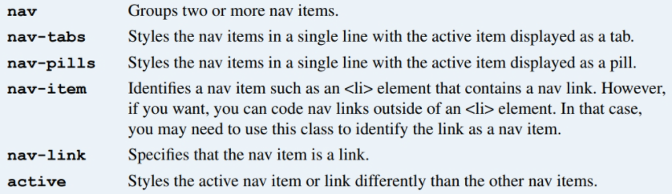
Common CSS classes for creating navs

Slide 33
Nav links styled as tabs
The HTML for the nav links
<nav class="nav nav-tabs">
<a class="nav-item nav-link active" href="/">Home</a>
<a class="nav-item nav-link" href="/products">
Products</a>
<a class="nav-item nav-link" href="/cart">Cart</a>
</nav>

Slide 34
The same nav links styled as pills
The HTML for the nav links
<nav class="nav nav-pills">
<a class="nav-item nav-link active" href="/">Home</a>
<a class="nav-item nav-link" href="/products">
Products</a>
<a class="nav-item nav-link" href="/cart">Cart</a>
</nav>

Slide 35
A more verbose way of coding the same nav links
<ul class="nav nav-pills">
<li class="nav-item">
<a class="nav-link active" href="/">Home</a>
</li>
<li class="nav-item">
<a class="nav-link" href="/products">Products</a>
</li>
<li class="nav-item">
<a class="nav-link" href="/cart">Cart</a>
</li>
</ul>

Slide 36
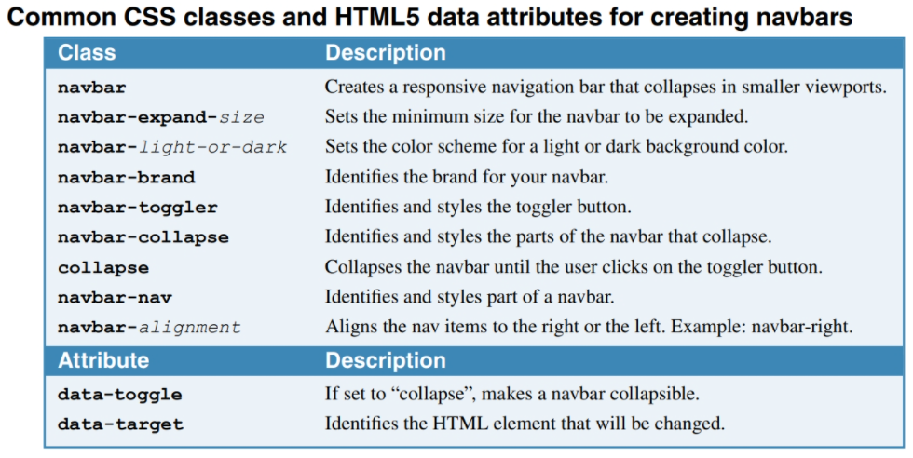
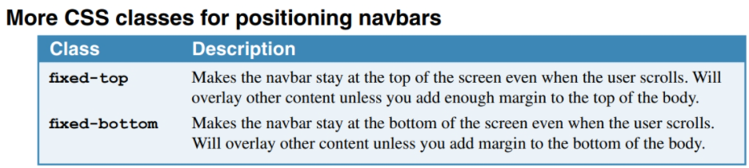

Slide 37
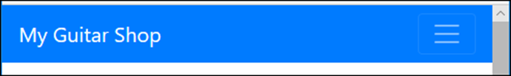
A navbar expanded on a wide screen
A navbar expanded on a small screen

Slide 38
The HTML for the navbar (part 1)
<nav class="navbar navbar-expand-md navbar-dark bg-primary">
<a class="navbar-brand" href="/">My Guitar Shop</a>
<button class="navbar-toggler" type="button"
data-toggle="collapse"
data-target="#navbarSupportedContent"
aria-controls="navbarSupportedContent"
aria-expanded="false"
aria-label="Toggle navigation">
<span class="navbar-toggler-icon"></span>
</button>
<nav class="collapse navbar-collapse"
id="navbarSupportedContent">
<div class="navbar-nav mr-auto">
<a class="nav-item nav-link active" href="/">Home</a>
<a class="nav-item nav-link"
href="/products">Products</a>
<a class="nav-item nav-link" href="/about">About</a>
</div>

Slide 39
The HTML for the navbar (part 2)
<div class="navbar-nav navbar-right">
<a class="nav-item nav-link" href="/cart">
<span class="fas fa-shopping-cart"></span>
&nbsp;Cart&nbsp;
<span class="badge badge-primary">2</span>
</a>
</div>
</nav>
</nav>

Slide 40
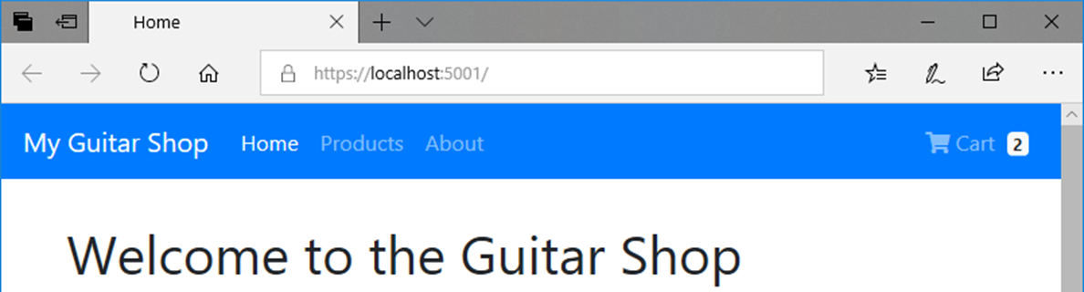
The HTML that displays the navbar
<body>
<nav class="navbar navbar-expand-md navbar-dark
bg-primary fixed-top">
<!-- navbar items go here -->
</nav>
<div class="container">
<!-- container items go here -->
</div>
</body>

Slide 41
Bootstrap: The Container

Slide 42
Bootstrap’s top-level containers
Bootstrap's grid system, which we’ll dive into next, allows you to specify rows and columns of your layout
But these rows and columns are contained within Bootstrap’s top-level container elements
These come in 2 forms:
Fixed width, and
Fluid width
Both have a left & right padding of 15px

Slide 43
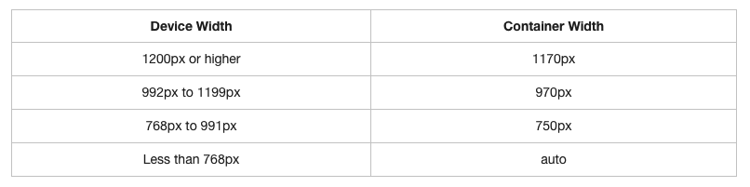
Fixed width containers
Have different fixed widths in different sized devices, as shown in this table:

Slide 44
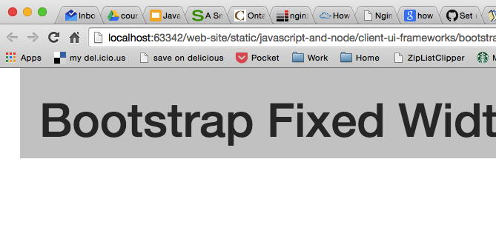
A fixed width example:
<div class="container">
<h1>Bootstrap Fixed Width Container</h1>
</div>

Slide 45
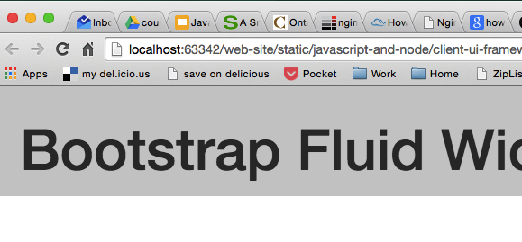
And a fluid width example:
<div class="container-fluid">
<h1>Bootstrap Fluid Width Container</h1>
</div>

Slide 46
Where...
Fluid-width containers do not have a fixed width
i.e. they are always the width of the device
So next…
What do we put in these containers?

Slide 47
Bootstrap’s screen size codes
Bootstrap using the following size codes:
col-xs-
For extra small displays - i.e. screen width < 768px
col-sm-
For smaller displays – i.e screen width ≥ 768px
col-md-
For medium displays – i.e. screen width ≥ 992px
col-lg-
For larger displays – i.e. screen width ≥ 1200px

Slide 48
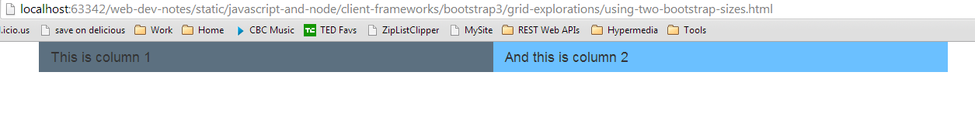
Which produces…
The following on say a desktop:
More precisely: anything in “sm” mode or above

Slide 49
structural/layout row vs content row
This last example serves to highlight an extremely important concept, namely:
There can be 2 different meanings to “row” here
Bootstrap’s grid system defines a grid for structuring your layout
As such a row in Bootstrap is a structural layout row
It may turn out that there are multiple “rows of content”
As with the last example in xs mode

Slide 50
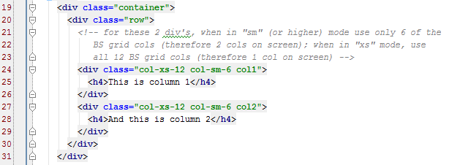
That is...
Here we have 1 structural/layout row and, in xs-mode only, 2 content rows:
structural/layout row
content row

Slide 51
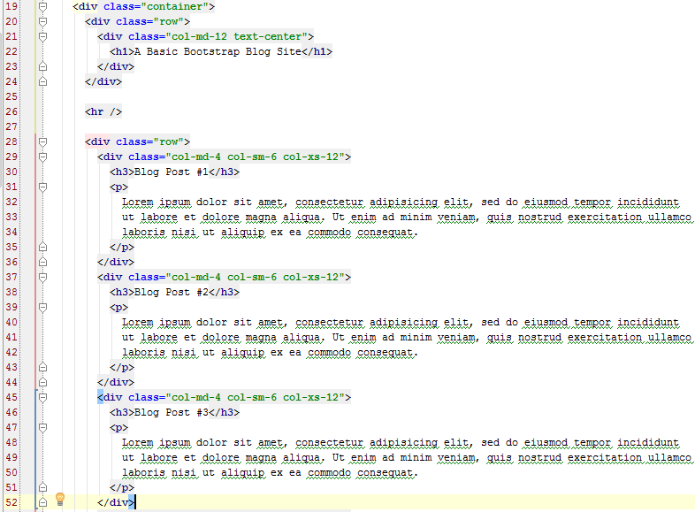
That is, we have…

Slide 52
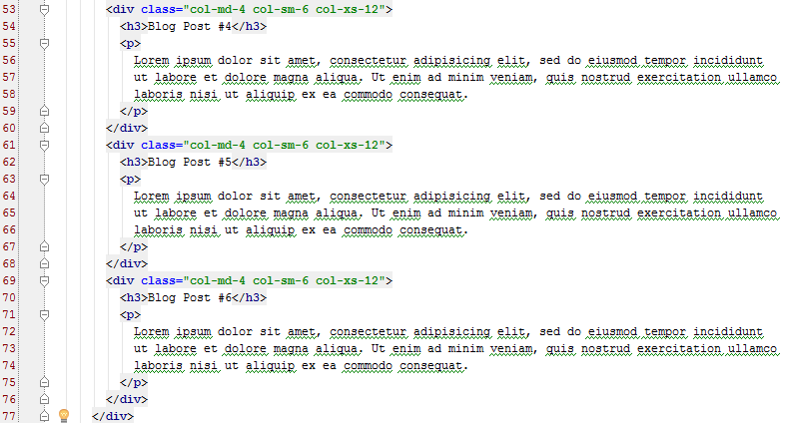
And…

Slide 53
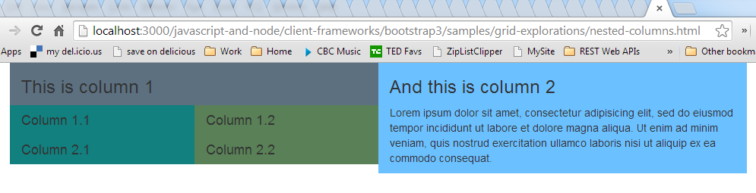
Which produces…

Slide 54
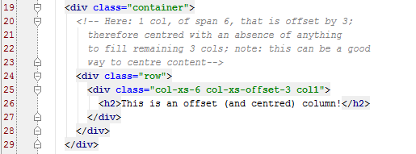
Offsetting Columns
Jumping right to an example:

Slide 55
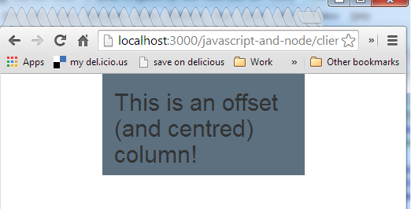
Which produces…

Slide 56
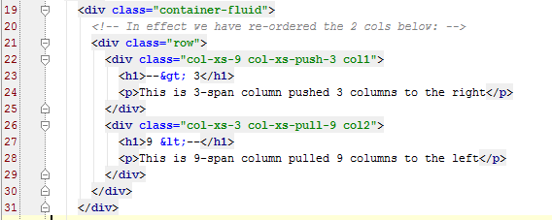
Pushing & Pulling (reordering) columns
Again, jumping right to an example:

Slide 57
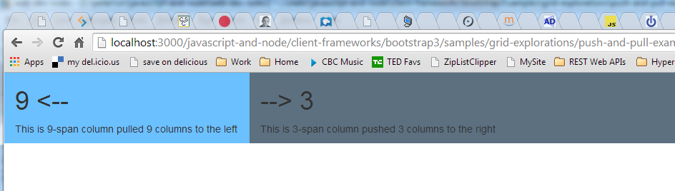
Which produces…

Slide 58
Bootstrap Resources
For a wide array of free Bootstrap templates…
http://www.bootstrapzero.com/
http://themes.getbootstrap.com/
Nice dashboard template:
http://demos.creative-tim.com/light-bootstrap-dashboard/dashboard
And are you sure you want/need Bootstrap?
If not, then this might help you decide:
http://blog.creative-tim.com/web-design/use-not-use-bootstrap-framework/
If you want a sense of how complicated the work is that Bootstrap (and other CSS frameworks) does behind the scenes:
http://www.sitepoint.com/easy-responsive-css-grid-layouts/

